Slide 1
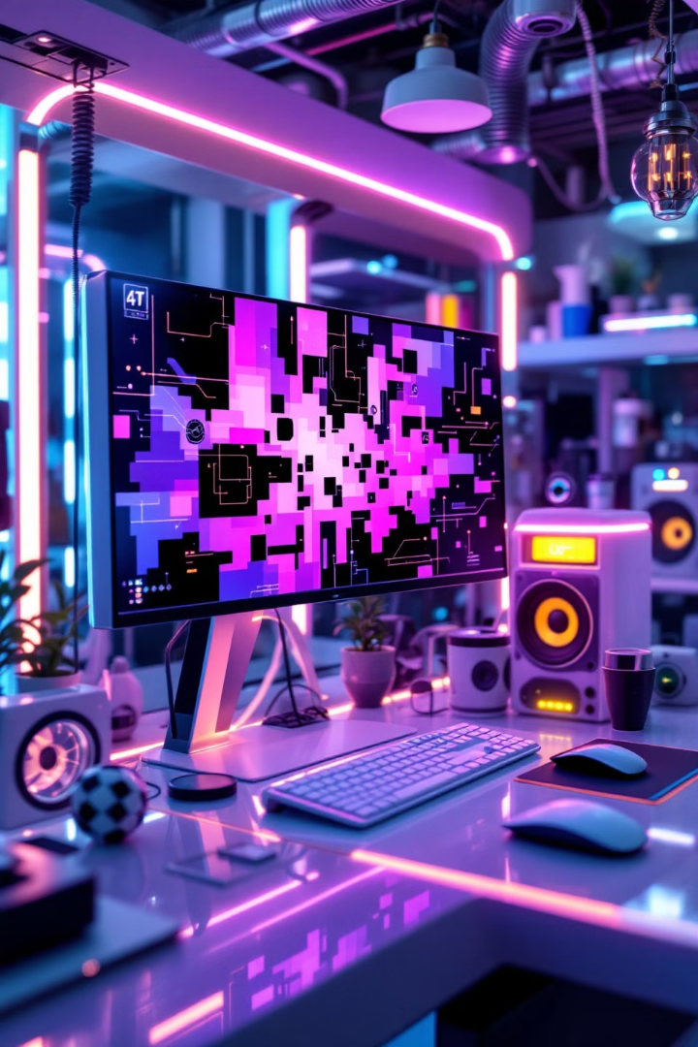

Mastering Image Manipulation with OpenCV
Welcome to this comprehensive guide on image manipulation using OpenCV! Throughout this presentation, we'll explore fundamental techniques for working with digital images - from accessing and modifying individual pixels to extracting valuable information from images.
OpenCV (Open Source Computer Vision Library) is a powerful tool that allows us to analyze and transform images with just a few lines of code. Whether you're new to computer vision or looking to strengthen your foundation, these techniques will serve as essential building blocks for more advanced applications.
by EMRE Akpınar

Slide 2
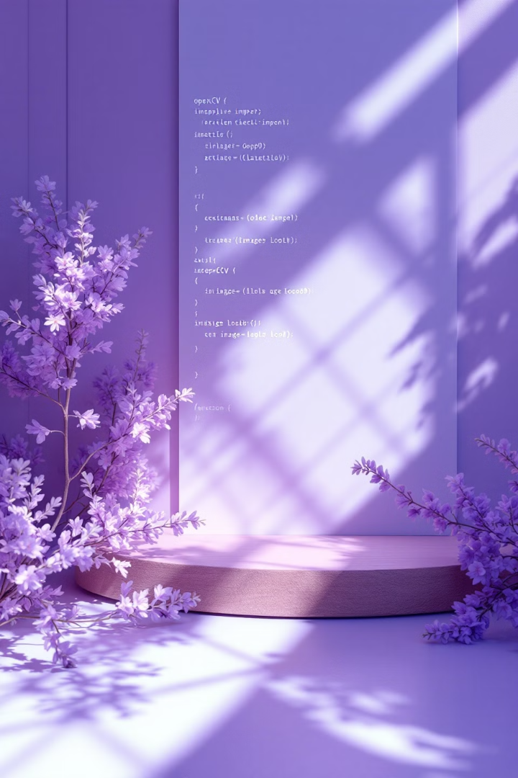
Setting Up Your OpenCV Environment
Import Libraries
Load An Image
Start by importing the cv2 library, which provides all the functions we need for image manipulation:
Use cv2.imread() to read an image file into your program:
image = cv2.imread("filename.jpg")
import cv2
Convert To Grayscale
Many operations work better on grayscale images:
gray_image = cv2.cvtColor(image, cv2.COLOR_BGR2GRAY)

Slide 3
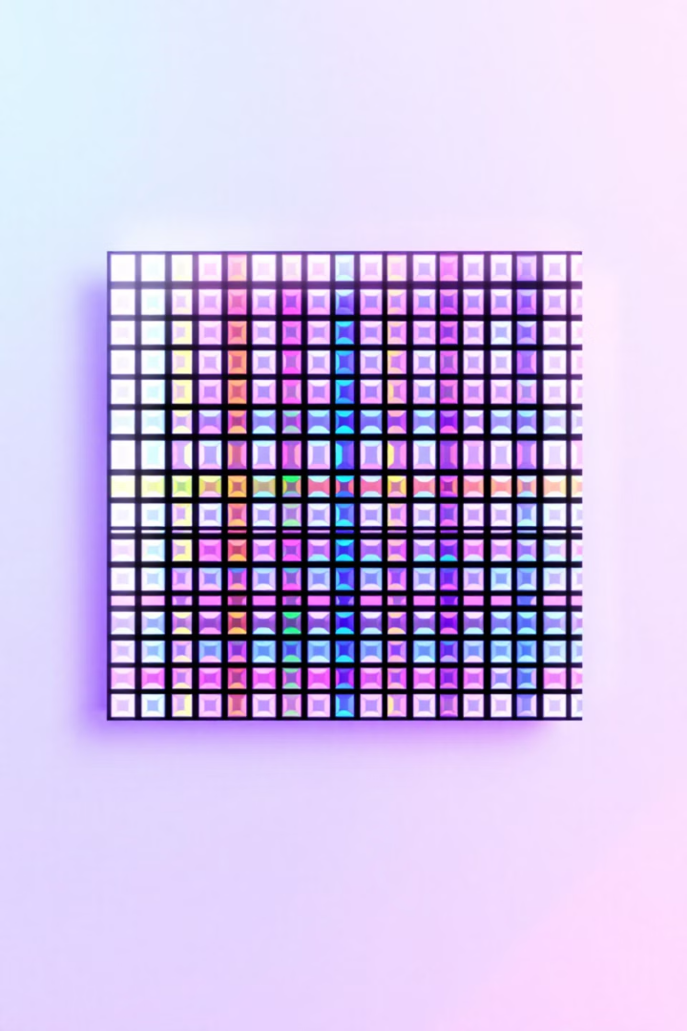
Understanding Image Representation
1
Images as Arrays
2
BGR Color Format
In OpenCV, images are represented as multi-dimensional NumPy arrays. Color images typically have three dimensions: height, width, and color channels.
Unlike most image formats that use RGB (Red, Green, Blue), OpenCV uses BGR (Blue, Green, Red) order for color channels. This is an important distinction to remember when working with colors.
3
Grayscale Images
Grayscale images have only one channel, with pixel values ranging from 0 (black) to 255 (white). They simplify many computer vision tasks by reducing complexity.

Slide 4
Accessing Pixel Values
Individual Pixel Access
Color Images
Grayscale Images
You can access any pixel using its coordinates with the syntax:
For color images, this returns an array of three values representing BGR:
For grayscale images, the same syntax returns a single value representing brightness:
pixel_value = image[y, x]
[B, G, R]
brightness = gray_image[y, x]
Remember that y comes first (row) then x (column)!
For example, a white pixel would return [255, 255, 255], while a red pixel would be [0, 0, 255].

Slide 5
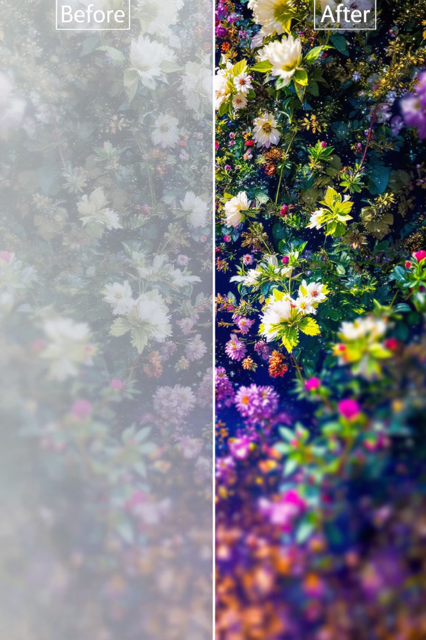



Modifying Pixels
Individual Modifications
Region Modifications
Viewing Changes
Display the modified image with:
Change a single pixel's color by assigning new BGR values:
Modify multiple pixels using loops to create visible effects:
cv2.imshow("Modified Image", image)
cv2.waitKey(0)
cv2.destroyAllWindows()
for y in range(50):
for x in range(50):
image[y, x] = [0, 0, 255]
image[10, 10] = [0, 255, 255]
This would set the pixel at coordinates (10,10) to yellow (B=0, G=255, R=255).
This turns a 50×50 region red.

Slide 6
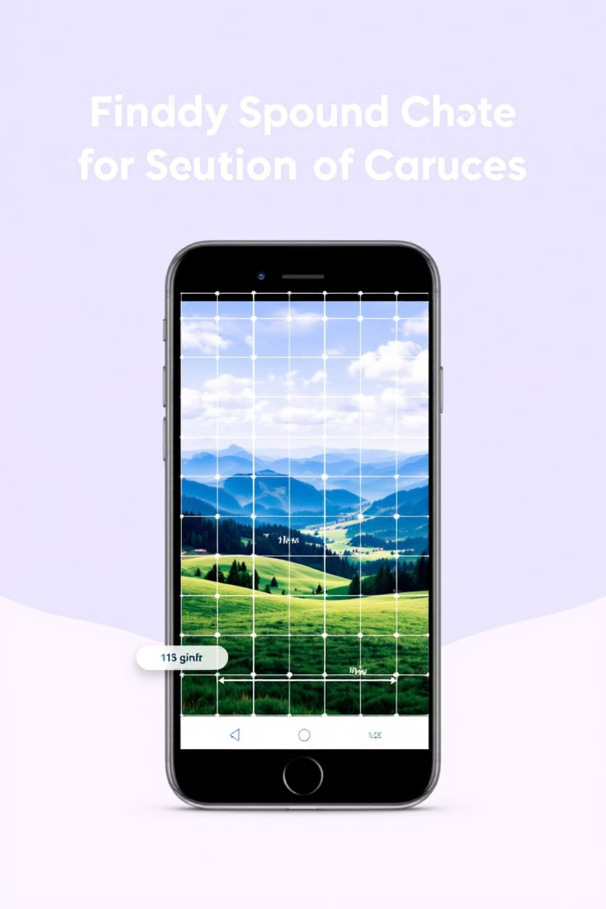



Getting Image Dimensions
Access Shape Property
Use the shape property to get image dimensions:
dimensions = image.shape
For color images, this returns a tuple of (height, width, channels).
Extract Individual Values
Unpack the dimensions:
height, width, channels = image.shape
For grayscale images, use:
height, width = gray_image.shape
Use In Your Code
Knowing dimensions helps ensure operations stay within image boundaries and allows for dynamic processing based on image size.

Slide 7
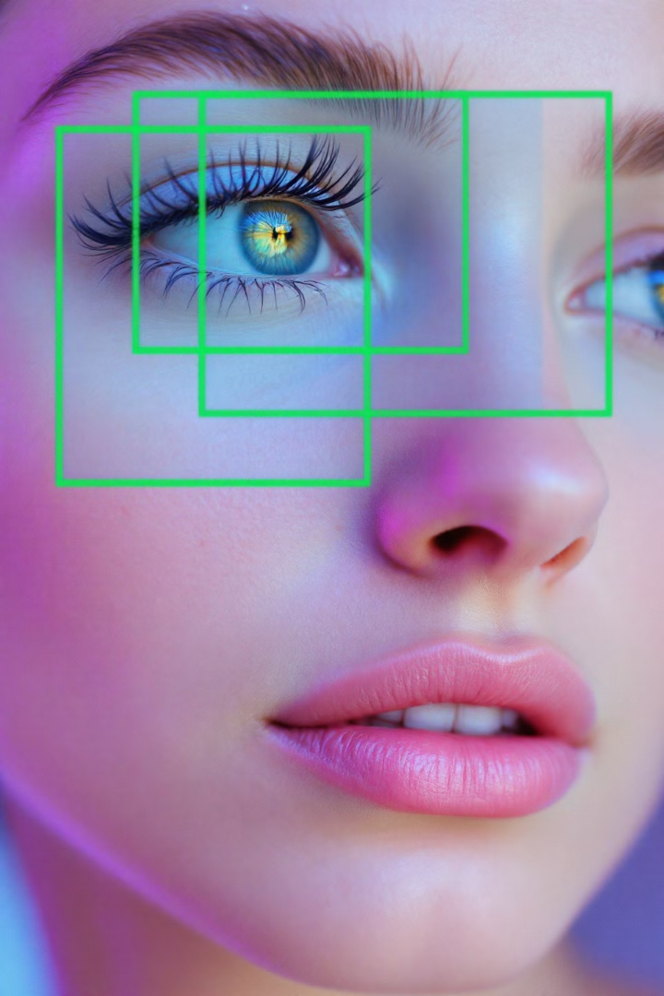
Region of Interest (ROI)
1
Define Region
Identify the coordinates for your region of interest. For example, to extract a face from an image, determine the approximate coordinates (x1, y1) for the top-left corner and (x2, y2) for the bottom-right corner.
2
Extract Region
Use image slicing to extract the region:
roi = image[y1:y2, x1:x2]
This creates a new image containing only the specified area.
3
Process Separately
You can now process or display this region independently:
cv2.imshow("Region of Interest", roi)

Slide 8
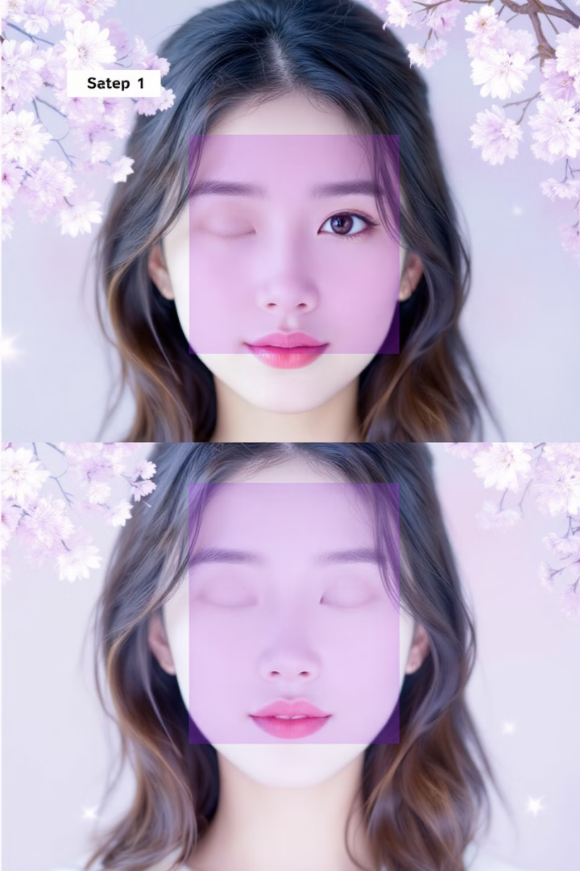
Practical Example: Face Cropping
Identify Coordinates
Open your image in an editor like Paint to find the approximate pixel coordinates of the face. For example, a face might be located at coordinates (100, 50) to (300, 250).
Extract Face Region
Use slicing to crop just the face:
face = image[50:250, 100:300]
Further Refinement
Extract smaller regions like eyes:
left_eye = face[30:50, 20:60]

Slide 9





Image Manipulation Applications
Object Detection
Face Recognition
2
Identify and locate objects in scenes
Extract facial features for identification
1
Image Filtering
Apply effects and enhance details
3
Image Segmentation
5
Separate image into meaningful regions
Feature Extraction
4
Detect corners, edges, and key points
These fundamental pixel manipulation techniques form the basis for more complex computer vision applications. By understanding how to access and modify pixel values, and how to work with regions of interest, you'll be able to build powerful image processing tools.

Slide 10




Common Pitfalls and Solutions
Image Boundaries
1
Always check dimensions before operations
Color Channel Order
2
Remember OpenCV uses BGR, not RGB
Grayscale vs. Color
3
Shape property returns different values
Image Dimensions
4
Y-coordinate (rows) comes before X (columns)
When working with OpenCV, these common mistakes can cause frustrating errors. Always remember that OpenCV uses the BGR color order instead of the more common RGB. Also, when accessing pixels or slicing regions, the Y-coordinate (row) comes before the X-coordinate (column).
For grayscale images, remember that image.shape returns only height and width, while for color images it returns height, width, and channels. This difference can cause errors if not handled properly.

Slide 11
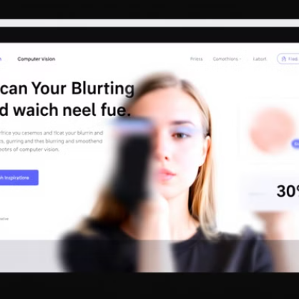
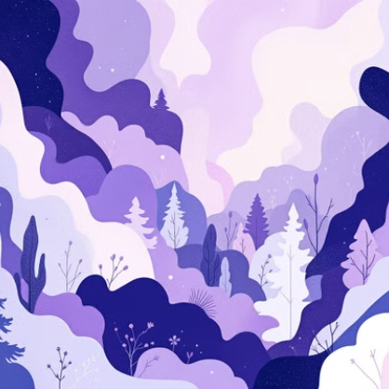
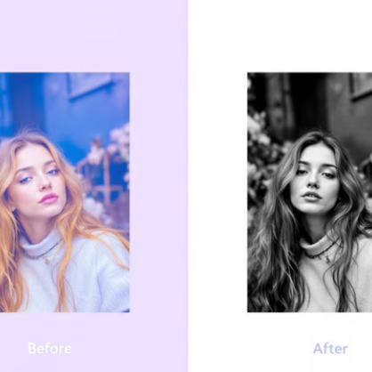
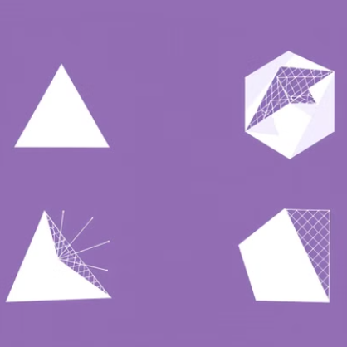
Next Steps in Your OpenCV Journey
Congratulations on mastering the basics of image manipulation with OpenCV! You now understand how to access and modify pixels, work with image dimensions, and extract regions of interest - fundamental skills for any computer vision project.
As you continue your journey, explore more advanced techniques like image filtering, edge detection, thresholding, and feature extraction. These build upon the foundation you've established today and will allow you to create sophisticated computer vision applications.
Remember that practice is key - try applying these techniques to your own images and see what creative solutions you can develop!

